Slide 1
CS 111 Operating Systems
Week 2
01/17/2020

Slide 2
Things we are going to discuss:
Overview of Project 1A :The Big Picture
Termios
Struct termios
tcsetattr, tcgetattr
Demo
Reference: https://blog.nelhage.com/2009/12/a-brief-introduction-to-termios/
Fork
Demo
Pipe
Demo
Reference: https://www.tldp.org/LDP/lpg/node10.html
Poll
stty sane

Slide 3
And as you know:
Project 1A due on Wednesday (01/22/2020) at 11:59 PM
Late Policy : Exponential as discussed previously
Please remember to download your submissions and check if you submitted the correct files. Empty submissions - or submissions in the wrong format - cannot be graded and will therefore be scored with a 0

Slide 4
Project 1A: Multi-process telnet-like client and server
Build a multi-process telnet-like client and server:
Character-at-a-time, full duplex terminal I/O
Polled I/O and passing input and output between two processes
What is telnet?
Telnet is a protocol that allows you to connect to remote computers (called hosts) over a TCP/IP network (such as the internet).
Using telnet client software on your computer, you can make a connection to a telnet server (that is, the remote host). Once your telnet client establishes a connection to the remote host, your client becomes a virtual terminal, allowing you to communicate with the remote host from your computer
Telnet has Full Duplex Communication
We are going to build a multi process telnet-like client and server

Slide 5
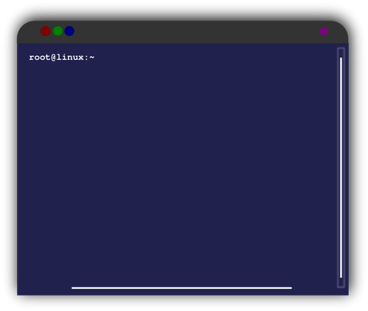

The big picture
The server program will connect with the client, receive the client's commands and send them to the shell, and will "serve" the client the outputs of those commands.
stdin
(forward)stdin
Shell: Simply a macro processor that executes commands.
stdout
stdout
User types into keyboard
Terminal Process
Shell (forked)
(Client)
(Server)

Slide 6
Character-at-a-time, full duplex terminal I/O
The project spec says:
“put the keyboard (the file open on file descriptor 0) into character-at-a-time, no-echo mode (also known as non-canonical input mode with no echo). It is suggested that you get the current terminal modes, save them for restoration, and then make a copy with only the following changes:
c_iflag = ISTRIP; /* only lower 7 bits */
c_oflag = 0; /* no processing */
c_lflag = 0; /* no processing */
and these changes should be made with the TCSANOW option”
Let’s talk about Termios( tcsetattr, tcgetattr), Echo, Non-Canonical, c_iflag/c_oflag/c_lflag.

Slide 7
A brief introduction to Termios
Termios is responsible for things like:
If you press ^C or ^Z it kills or stops the foreground program
The primary abstraction that governs any interaction with a terminal in Unix is a “terminal” device, or tty for short.
In most cases these days, since you’re not interacting with a physical terminal, you’ll be dealing with a “pseudo-terminal” or pty
What makes terminal devices special is the layer that sits between the master and slave, which can filter, transform, and act upon the streams in both directions.
Notes:
A tty is a terminal (it stands for teletype - the original terminals used a line printer for output and a keyboard for input!). A terminal is a basically just a user interface device that uses text for input and output.
A pty is a pseudo-terminal - it's a software implementation that appears to the attached program like a terminal, but instead of communicating directly with a "real" terminal, it transfers the input and output to another program.
For example, when you ssh in to a machine and run ls, the ls command is sending its output to a pseudo-terminal, the other side of which is attached to the SSH daemon.

Slide 8
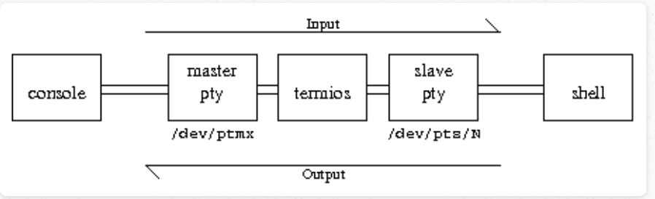
In standard usage, the “master” pty is connected to your terminal emulator (e.g. xterm, ssh), and the “slave” pty is connected to the program being run (e.g. your shell). “Input” flows from the user into the master pty and out the slave, and “output” flows from your program into the slave and then out the master. The basic diagram for what’s going on, then is:

Slide 9
What happens in the middle?
Line buffering – when characters come in the left, it holds on to them until it receives a newline, at which point they are all emitted out the right at once.
Echo – when a character comes in the left, in addition to being buffered or sent out the right, it is also sent back out the left. This is why you can see what you’re typing.
There is even more that happens in that box, but these are the most noticeable ones, and selected to give you a feel of how the system works.
Programs using the terminal can selectively enable or disable each of these features individually (like ECHO, ICANON)

Slide 10
Canonical vs Non-canonical input
Canonical Input:
The entire line is gathered and edited up until the end of line character — Return — is pressed. Thereupon, the whole line is made available to waiting programs.
Depending on the read() system calls that are outstanding, the whole line will be available to be read (by one or more calls to read()).
Non-canonical input:
For non-canonical input — think vi or vim or whatever — you press a character, and it is immediately available to the program.
You aren't held up until you hit return. The system does no editing of the characters; they are made available to the program as soon as they are typed.
Is the input buffer bypassed completely?
With non-canonical input, the input buffer is still used; if there is no program with a read() call waiting for input from the terminal, the characters are held in the input buffer. What doesn't happen is any editing of the input buffer.

Slide 11
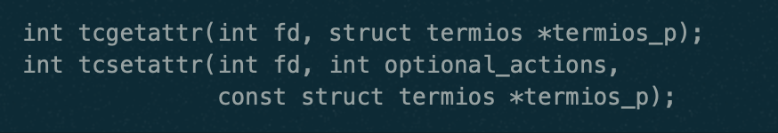
Termios in greater detail
The primary programmatic interface to termios is:
struct termios, and
Two functions which retrieve & set the struct termios associated with a given terminal device

Slide 12
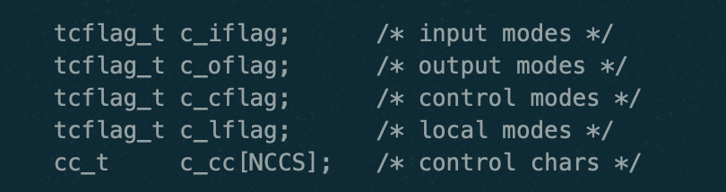
So what’s inside struct termios?
POSIX specifies that this structure contains at least the following fields:
Each “flag” field contains a number of flags (implemented as a bitmask) that can be individually enabled or disabled (such as “tattr.c_lflag &= ~(ICANON|ECHO);” disables ICANON and ECHO)
c_iflag and c_oflag contain flags that affect the processing of input and output, respectively
c_cflag we will mostly ignore, as it contains settings that relate to the control of modems and serial lines that are mostly irrelevant these days
c_lflag is perhaps the most interesting of the flag values. It contains flags that control the broad-scale behavior of the tty.

Slide 13
Some local modes inside of c_lflag,c_iflag
c_lflag:
ICANON - Enabling it enables “canonical” mode – also known as “line editing” mode. When ICANON is set (canonical mode), the terminal buffers a line at a time, and enables line editing. Without ICANON (non-canonical mode ), input is made available to programs immediately (this is also known as “cbreak” mode)
ECHO in c_lflag controls whether input is immediately re-echoed as output.
Example: When password prompts for your password, your terminal is in canonical mode, but ECHO is disabled.
c_iflag:
ISTRIP is a c_iflag flag constant which strips off eighth bit

Slide 14
Storing current terminal mode and restoring
In the spec, you are asked to do the following (and these changes should be made with the TCSANOW [which is a part of tcsetattr] option)
In order to do so, you should be familiar with two important functions as discussed in the next slide

Slide 15
Storing current terminal mode and restoring
tcsetattr
Header file to include: #include <termios.h>
Function Signature:
int tcsetattr(int fildes, int optional_actions, const struct termios *termios_p);
tcgetattr
Header file to include: #include <termios.h>
Function Signature:
int tcgetattr(int fildes, struct termios *termios_p);

Slide 16
Tcsetattr in detail:
int tcsetattr(int fildes, int optional_actions, const struct termios *termios_p);
The tcsetattr() function sets the parameters associated with the terminal referred to by fildes from termios, according to the following requested action:
TCSANOW : The change occurs immediately
TCSAFLUSH : The change occurs after all output written to the file descriptor has been transmitted, and all input so far received but not read is discarded before the change is made.
The tcsetattr() function returns successfully if it was able to perform any of the requested actions, even if some of the requested actions could not be performed.
If no part of the request can be completed, tcsetattr() returns -1 and sets errno to EINVAL.

Slide 17
Tcgetattr in detail:
int tcgetattr(int fildes, struct termios *termios_p);
The tcgetattr() function shall get the parameters associated with the terminal referred to by fildes and store them in the termios structure referenced by termios_p.
The fildes argument is an open file descriptor associated with a terminal.
The termios_p argument is a pointer to a termios structure.
Upon successful completion, 0 shall be returned. Otherwise, -1 shall be returned and errno set to indicate the error.

Slide 18
Demo
void set_input_mode (void){
struct termios tattr;
char *name;
/* Make sure stdin is a terminal. */
if (!isatty (STDIN_FILENO)){
fprintf (stderr, "Not a terminal.\n");
exit (EXIT_FAILURE);
}
/* Save the terminal attributes so we can restore them later. */
tcgetattr (STDIN_FILENO, &saved_attributes);
atexit (reset_input_mode);
/* Set the funny terminal modes. */
tcgetattr (STDIN_FILENO, &tattr);
tattr.c_lflag &= ~(ICANON|ECHO);
tattr.c_cc[VMIN] = 1;
tattr.c_cc[VTIME] = 0;
tcsetattr (STDIN_FILENO, TCSAFLUSH, &tattr);
}
int main (void){
char c;
set_input_mode ();
while (1) {
read (STDIN_FILENO, &c, 1);
if (c == '\004')
break;
else
putchar (c);
}
return EXIT_SUCCESS;
}
#include <unistd.h>
#include <stdio.h>
#include <stdlib.h>
#include <termios.h>
/* Use this variable to remember original terminal
attributes. */
struct termios saved_attributes;
void reset_input_mode (void) {
tcsetattr (STDIN_FILENO, TCSANOW, &saved_attributes);
}

Slide 19
Passing input and output between two processes
The project spec says:
“fork to create a new process, and then exec a shell (/bin/bash, with no arguments other than its name), whose standard input is a pipe from the terminal process, and whose standard output and standard error are (dups of) a pipe to the terminal process. (You will need two pipes, one for each direction of communication, as pipes are unidirectional.)”
Let’s talk about fork and pipe.

Slide 20
Fork
Fork system call is used for creating a new process, which is called child process, which runs concurrently with the process that makes the fork() call (parent process).
After a new child process is created, both processes will execute the next instruction following the fork() system call.
A child process uses the same pc(program counter), same CPU registers, same open files which are used by the parent process.
It takes no parameters and returns an integer value.

Slide 21
Fork
Below are different values returned by fork().
Negative Value: creation of a child process was unsuccessful.
Zero: Returned to the newly created child process.
Positive value: Returned to parent or caller. The value contains process ID of newly created child process

Slide 22
Fork demo 1
#include <stdio.h>
#include <sys/types.h>
#include <unistd.h>
int main() {
// make two process which run same program after this instruction
fork();
printf("Hello world!\n");
return 0;
}

Slide 23
Fork Demo 1 Output
Hello World!
Hello World!

Slide 24
Fork Demo 2
#include <stdio.h>
#include <sys/types.h>
int main() {
fork();
fork();
fork();
printf("hello\n");
return 0;
}

Slide 25
Fork Demo 2 Output
hello
hello
hello
hello
hello
hello
hello
hello

Slide 26
Fork Demo 3
#include <stdio.h>
#include <sys/types.h>
#include <unistd.h>
void forkexample() {
// child process because return value zero
if (fork() == 0)
printf("Hello from Child!\n");
// parent process because return value non-zero.
else
printf("Hello from Parent!\n");
}
int main() {
forkexample();
return 0;
}

Slide 27
Fork Demo 3 Output
Hello from Parent!
Hello from Child!
(or)
Hello from Child!
Hello from Parent!

Slide 28
Fork Demo 4
#include <stdio.h>
#include <sys/types.h>
#include <unistd.h>
void forkexample() {
int x = 1;
if (fork() == 0)
printf("Child has x = %d\n", ++x);
else
printf("Parent has x = %d\n", --x);
}
int main() {
forkexample();
return 0;
}

Slide 29
Fork Demo 4 Output
Parent has x = 0
Child has x = 2
(Or)
Child has x = 2
Parent has x = 0

Slide 30
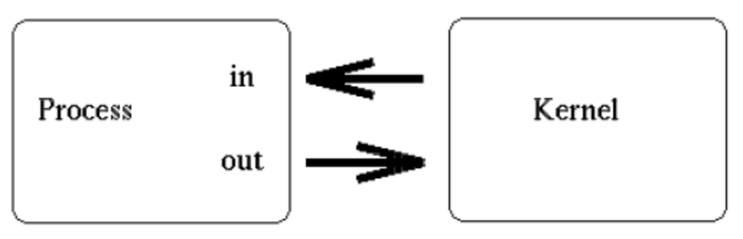
Pipe
Simply put, a pipe is a method of connecting the standard output of one process to the standard input of another
When a process creates a pipe, the kernel sets up two file descriptors for use by the pipe. One descriptor is used to allow a path of input into the pipe (write), while the other is used to obtain data from the pipe (read). Consider this representation of a process and the kernel after a pipe has been created:
At this point, the pipe is fairly useless. After all, why go to the trouble of creating a pipe if we are only going to talk to ourself?

Slide 31
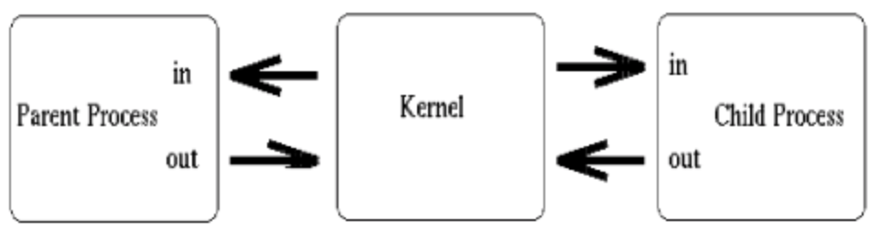
Pipe
At this point, the creating process typically forks a child process. Since a child process will inherit any open file descriptors from the parent, we now have the basis for multi-process communication (between parent and child). Consider this updated version of our simple sketch:

Slide 32
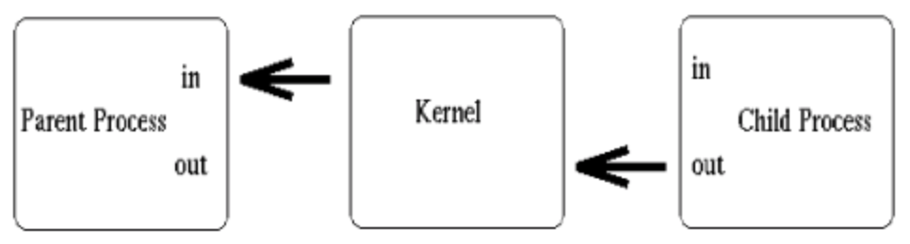
Pipe
Above, we see that both processes now have access to the file descriptors which constitute the pipeline. It is at this stage, that a critical decision must be made. In which direction do we desire data to travel?
Does the child process send information to the parent, or vice-versa? The two processes mutually agree on this issue, and proceed to close the end of the pipe that they are not concerned with.
For discussion purposes, let's say the child performs some processing, and sends information back through the pipe to the parent. Our newly revised sketch would appear as such:
Construction of the pipeline is now complete! The only thing left to do is make use of the pipe.

Slide 33
Pipe
To create a simple pipe with C, we make use of the pipe() system call. It takes a single argument, which is an array of two integers, and if successful, the array will contain two new file descriptors to be used for the pipeline.
After creating a pipe, the process typically spawns a new process (remember the child inherits open file descriptors).
System Call: pipe( );
Function Signature: int pipe( int fd[2] );
Returns:
0 on success
-1 on error: errno
To send data to the pipe, we use the write() system call, and to retrieve data from the pipe, we use the read() system call. Remember, low-level file I/O system calls work with file descriptors!

Slide 34
Demo
if(childpid == 0){
/*Child process closes up input side of pipe*/
close(fd[0]);
/*Send "string" through the output side of pipe*/
write(fd[1], string, (strlen(string)+1));
exit(0);
}else{
/*Parent process closes up output side of pipe*/
close(fd[1]);
/*Read in a string from the pipe*/ nbytes = read(fd[0], readbuffer, sizeof(readbuffer));
printf("Received string: %s", readbuffer);
}
return(0);
}
#include <stdio.h>
#include <unistd.h>
#include <sys/types.h>
int main(void) {
int fd[2], nbytes;
pid_t childpid;
char string[] = "Hello, world!\n";
char readbuffer[80];
pipe(fd);
if((childpid = fork()) == -1){
perror("fork");
exit(1);
}

Slide 35
Demo Output
Received string: Hello, world!

Slide 36
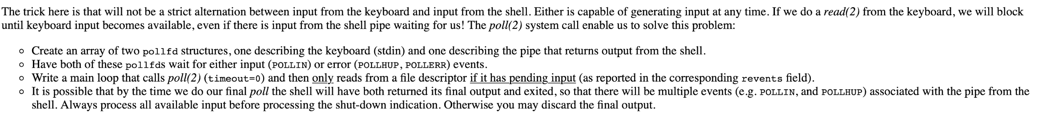
The poll system call
The spec says:

Slide 37
Poll
It waits for one of a set of file descriptors to become ready to perform I/O (input/output multiplexing)
Function Signature: int poll(struct pollfd *fds, nfds_t nfds, int timeout)
The set of file descriptors to be monitored is specified in the fds argument, which is an array of structures of the following form:
struct pollfd {
int fd; /* file descriptor */
short events; /* requested events */
short revents; /* returned events */
};

Slide 38
Poll return values
On success, a positive number is returned; this is the number of structures which have nonzero revents fields (in other words, those descriptors with events or errors reported).
A value of 0 indicates that the call timed out and no file descriptors were ready.
On error, -1 is returned, and errno is set appropriately.

Slide 39
Poll
The field fd contains a file descriptor for an open file.
If this field is negative, then the corresponding events field is ignored and the revents field returns zero.
This provides an easy way of ignoring a file descriptor for a single poll() call: simply negate the fd field. Note, however, that this technique can't be used to ignore file descriptor 0.

Slide 40
Poll flags
POLLIN There is data to read.
POLLERR Error condition (only returned in revents; ignored in events). This bit is also set for a file descriptor referring to the write end of a pipe when the read end has been closed.
POLLHUP Hang up (only returned in revents; ignored in events). Note that when reading from a channel such as a pipe or a stream socket, this event merely indicates that the peer closed its end of the channel. Subsequent reads from the channel will return 0 (end of file) only after all outstanding data in the channel has been consumed.

Slide 41
Demo
if (ret == -1) {
perror ("poll");
return 1;
}
if (!ret) {
printf ("%d seconds elapsed.\n", TIMEOUT);
return 0;
}
printf(“%d %d %d %d” , POLLIN, POLLOUT, fds[0].revents,fds[1].revents);
if (fds[0].revents & POLLIN)
printf ("stdin is readable\n");
if (fds[1].revents & POLLOUT)
printf ("stdout is writable\n");
return 0;
}
#include <stdio.h>
#include <unistd.h>
#include <sys/poll.h>
#define TIMEOUT 5
int main (void){
struct pollfd fds[2];
int ret;
/* watch stdin for input */
fds[0].fd = STDIN_FILENO;
fds[0].events = POLLIN;
/* watch stdout for output*/
fds[1].fd = STDOUT_FILENO;
fds[1].events = POLLOUT;
ret = poll(fds, 2, TIMEOUT * 1000);

Slide 42
Demo Output
Explanation:
POLLIN and POLLOUT are 1 and 4 respectively
The line fds[1].events = POLLIN, fds[0].events = POLLIN mean that the stdout,stdin are waiting for an input.
Once we type an input, fds[0].revents becomes 1 and fds[1].revents becomes 1
Once fds[0].revents becomes 1, fds[0].revents & POLLIN becomes 1
Once fds[1].revents becomes 1, fds[1].revents & POLLOUT becomes 1 & 4 = 0
Output:
./a.out
ls
POLLIN =1
POLLOUT = 4
fds[0].revents = 1
fds[1].revents= 1
stdin is readable

Slide 43
stty sane
Problem
Suppose you have aborted an SSH session and now you can’t see what you are typing. Or perhaps you accidentally displayed a binary file and your terminal window is now gibberish.
Solution
Type stty sane and then the Enter key, even if you can’t see what you are typing, to restore sane terminal settings. You may want to hit Enter a few times first, to make sure you don’t have anything else on your input line before you start typing the command.

Slide 44
Few Important Links
Pipe
https://www.geeksforgeeks.org/pipe-system-call/
https://www.geeksforgeeks.org/c-program-demonstrate-fork-and-pipe/
ASCII
http://www.asciitable.com/
Poll
http://man7.org/linux/man-pages/man2/poll.2.html
stty sane
http://www.peachpit.com/articles/article.aspx?p=659655&seqNum=13
Additional links:
http://man7.org/linux/man-pages/man3/termios.3.html
https://linux.die.net/man/3/tcgetattr
https://linux.die.net/man/3/tcsetattr
Termios
https://en.wikibooks.org/wiki/Serial_Programming/termios
https://blog.nelhage.com/2009/12/a-brief-introduction-to-termios/
Waitpid
https://linux.die.net/man/2/waitpid

Slide 45
Thank you!

